Slide 1




PAS Software Factory
PAS10: Sprint 19 Kick-Off
Oversight
June 27, 2016

Slide 2
Contents
1.0 RTC Scope Detail | 3
2.0 Scope Control | 4
3.0 Sprint Parameters | 5
4.0 Key Checkpoints for the Sprint | 6
5.0 Integrations Scope | 7
6.0 Impacts to the Schedule | 8
Appendix: Detailed Scope List | 9

Slide 3
1.0 RTC Scope Detail
PAS10 / Sprint 19
Executive Priorities | Work Item | # Scope Items | Story Points
CA HDES Conversion | WI0162 | 53 | 160
Enable Book roll in New Business and Capping | WI0340 | 14 | 32
* CA Prop Conversion SIS-DP3 and FoxPro-PUP | WI0208 | 45 | 93
UW Simplification - Phase 1 | WI0342 | 45 | 67
UBI Enhancements | WI0333 | 17 | 30
Left-over Auto or Property CRs | WI0344 | 21 | 46
Total |  | 195 | 428
* Includes 6 Integration User Stories

Slide 4
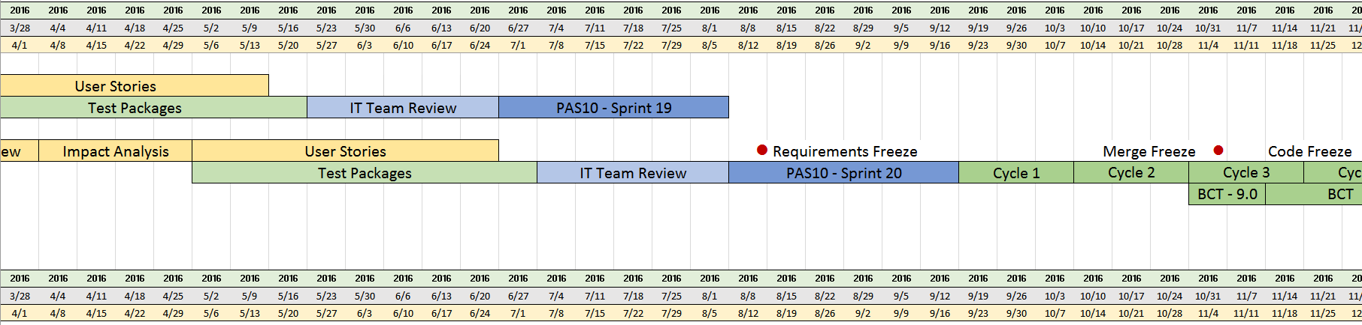
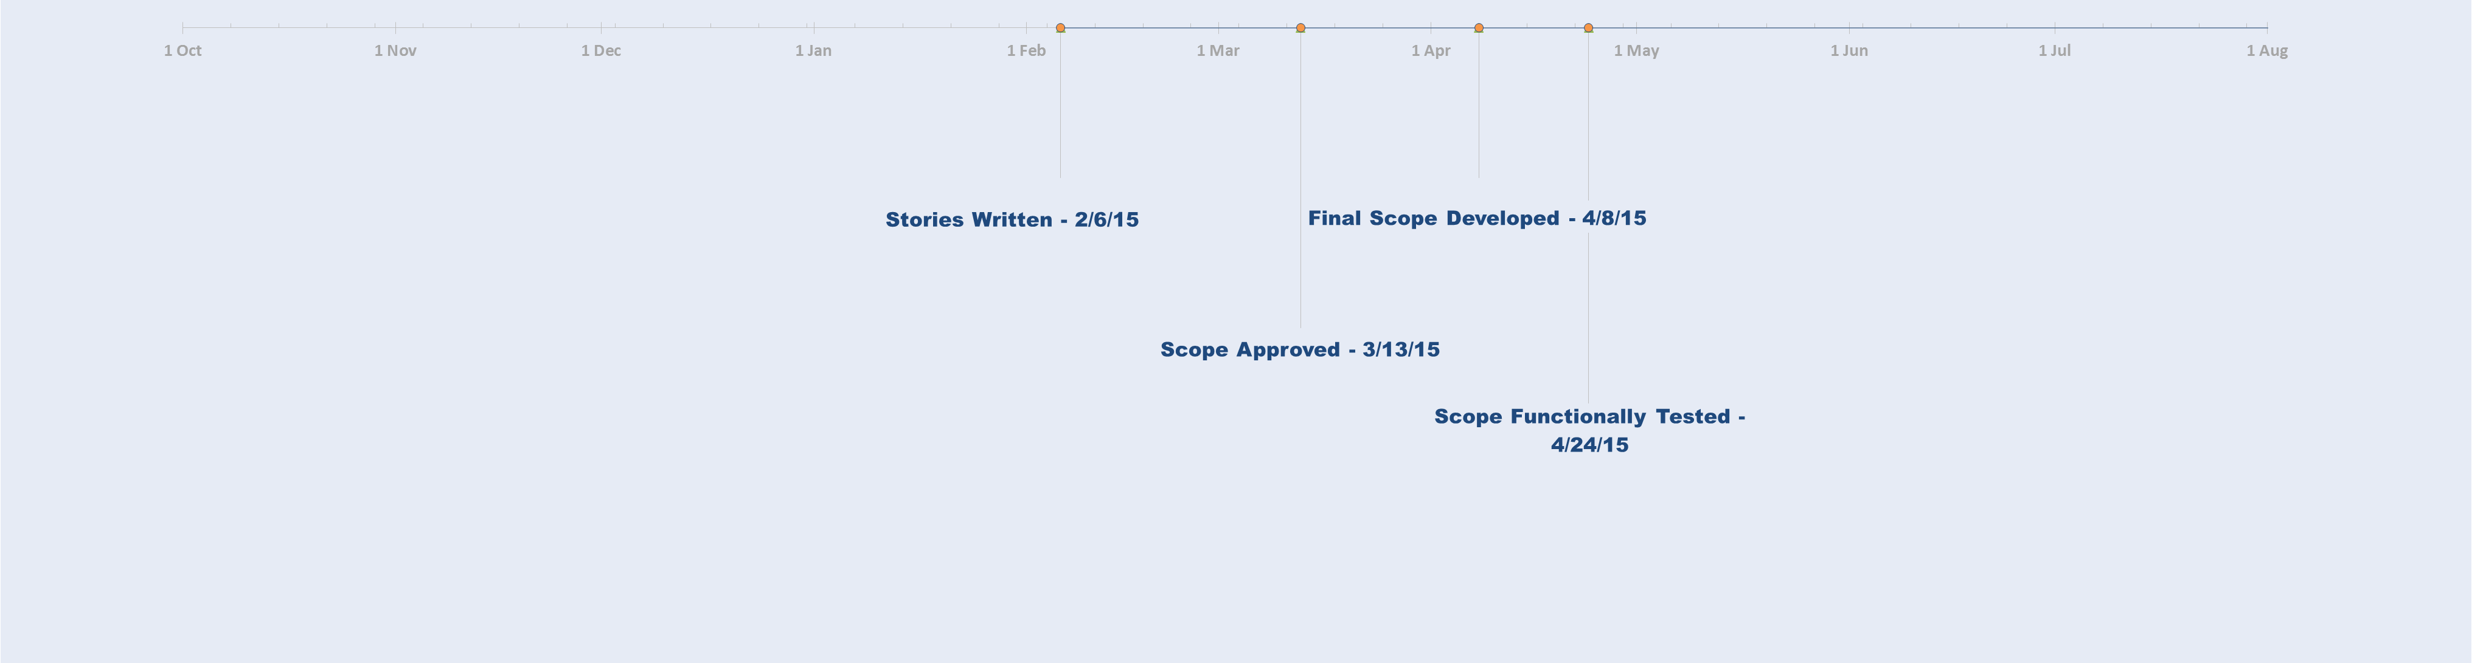
2.0 Scope Control
Functional Execution Complete 8/5/16
Stories Written 5/20/16
Final Scope Developed 7/25/16
We Are Here
Kick-Off 6/27/16
All CRs will be reviewed for their criticality. Change Requests are required for anything that requires more than a simple addition or subtraction of user stories, such as:
Adding a new work item
Deleting an existing work item
Changing the priority order of an existing work item
Friday, 8/12/16, is the Requirements Freeze date. It is the last business deadline to execute an approved change request without disrupting the overall timeline. Please note, however, that this “Vital Late-Breaking” capacity has already been consumed by the OK Property Product Changes Change Request work (WI0344 CR06).
Notes:
NOTE: After Final Feature Complete Build in the Second Sprint…
Scott Hunt will need to approve any Change Requests

Slide 5
3.0 Sprint Parameters
Functional Execution Complete 8/5/16
Stories Written 5/20/16
Final Scope Developed 7/25/16
Dev Timeframe
6 Weeks
Timeframe
6-week cadence: from today, Monday 6/27/16 to Friday, 8/5/16
Next Week: Sprint 20 IT Team Review
IT Team Review for the next sprint will also take place during the Sprint 19 timeframe
ITTR remains the customary 5 weeks, and begins one week into Sprint 19 (i.e. 7/5/16)
Some test packages (e.g. MVR Redesign) were planned to run one week into the IT Team Review for this release
Notes:
NOTE: After Final Feature Complete Build in the Second Sprint…
Scott Hunt will need to approve any Change Requests

Slide 6
4.0 Key Checkpoints for the Sprint
Two Dates
Final Scope Developed
New feature development should be 100% complete for scope defined in this kick-off deck by Monday morning, 7/25/16 (7:00 a.m. AZ Time)
Functional Execution Complete
Functional test execution should be 100% complete for scope defined in this kick-off deck by Friday evening, 8/5/16, (5:00 p.m. AZ Time)
The latest version of the PAS Timeline can be found on SharePoint:
PAS Timeline
Notes:
NOTE: After Final Feature Complete Build in the Second Sprint…
Scott Hunt will need to approve any Change Requests

Slide 7
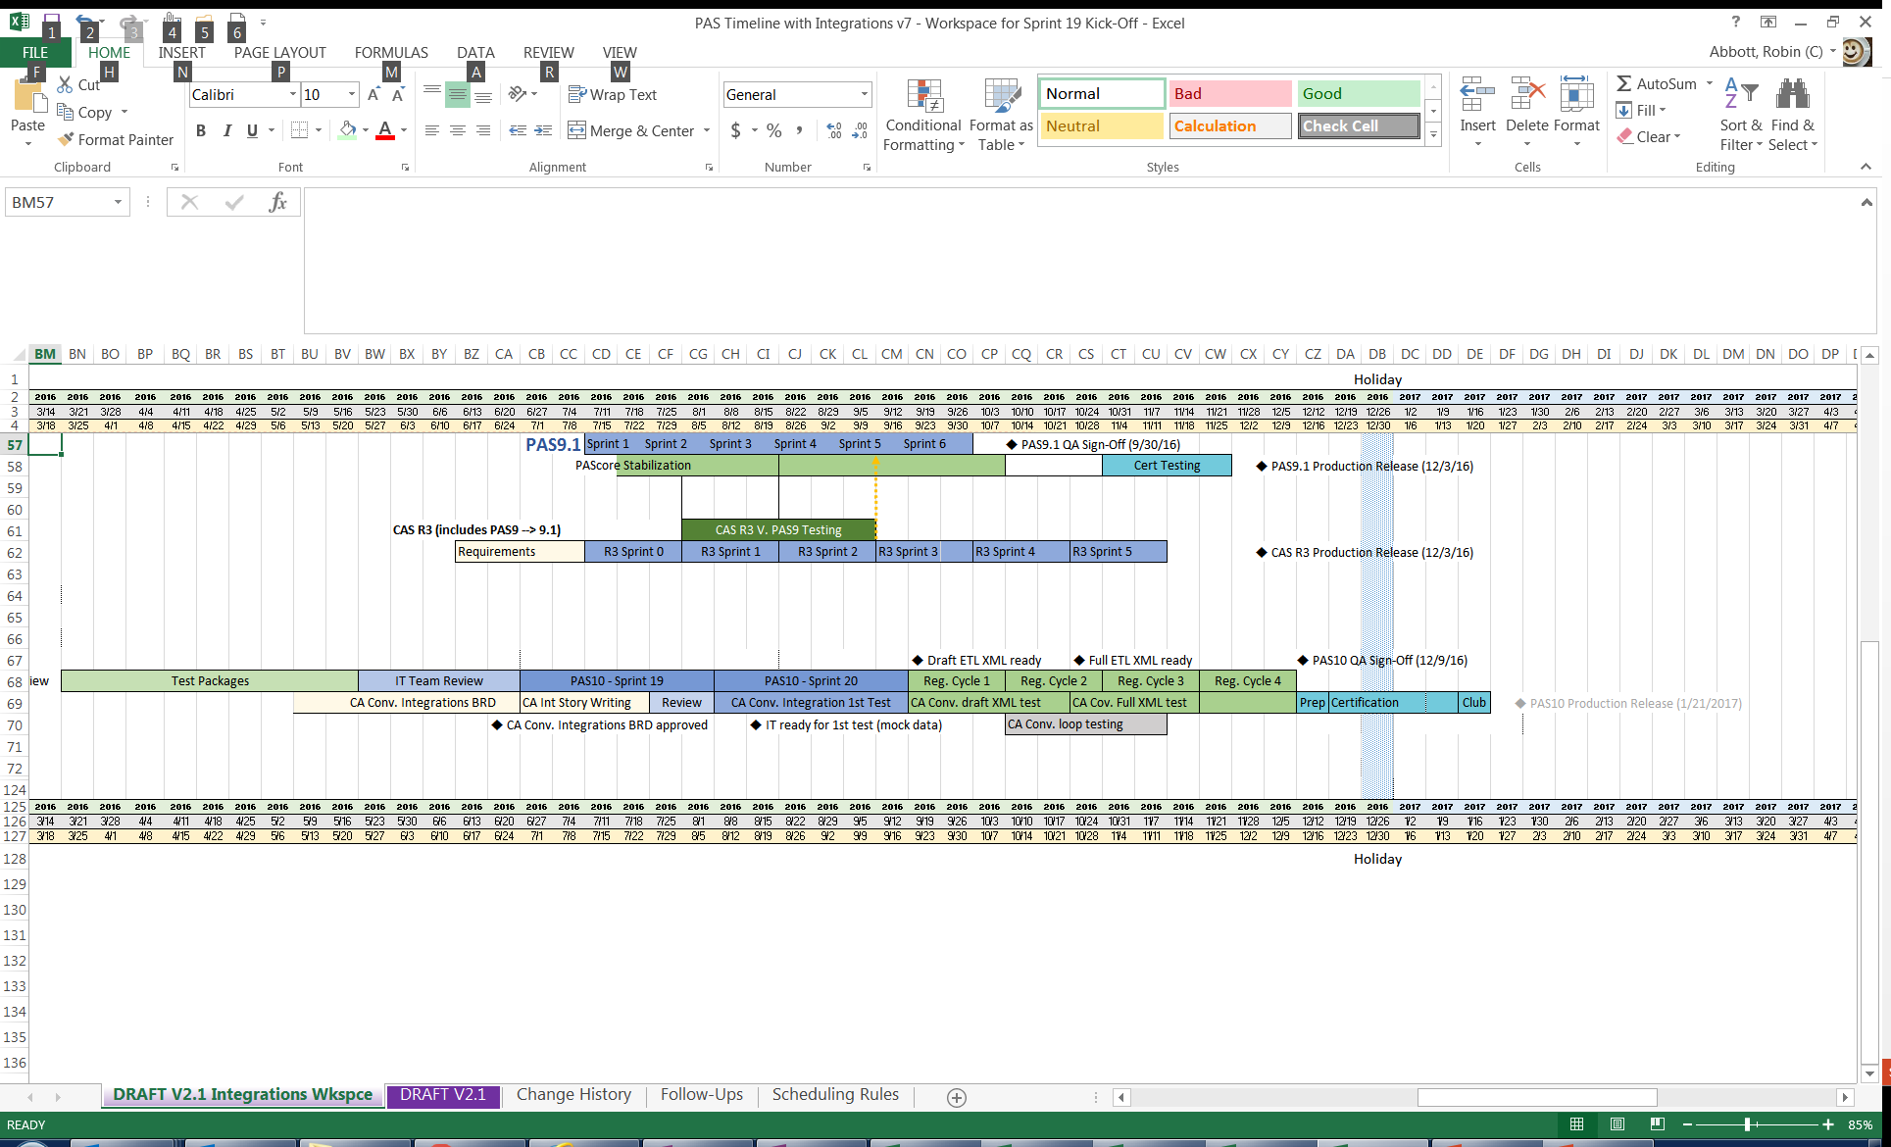
5.0 Integrations Scope
Integrations
Scope for Sprint 19
Sprint 19 Stories
H-INT-BTFDCNV-CA 27071: Debit balance transfer feed from SIS (636651)
H-INT-POLFDCNV-CA 27073: Send policy status feed to SIS (636652)
H-INT-CRSRFRCNV-CA 27133: Send policy cross reference feed (636663)
E-INT-XFDBCTCNV-CA 27170: CEA - Send policy cross reference feed to BCT (636669)
E-INT-FDBCTCNV-CA 27163: CEA - Feed to BCT (636668)
P-INT-CRSRFRCNV-CA 27165: Send policy cross reference feed (638583)
Sprint 20 Preparations of PAS Integrations Stories for CA Conversions
CA DP3-SIS
CA PUP-Fox Pro
CA HDES Conversion
Notes:
NOTE: After Final Feature Complete Build in the Second Sprint…
Scott Hunt will need to approve any Change Requests

Slide 8
6.0 Impacts to the Schedule
5.1 Holidays to Note
During Sprint 19: From June 27th through August 5th
6/ 29 /16: Dnepropetrovsk Holiday
7/ 03 /16: Minsk Holiday
7/ 04 /16: National Holiday for the US: Independence Day *
7/ 06 /16: Vilnius Holiday
* Most likely to affect onshore resources
5.2 Environments Maintenance Dates
 | Description | Date | Start/End Time | Duration
Sprint 19 | Patching Maintenance Window | 7/1/16 | 1p / 5p | 4 hours
 | Patching Maintenance Window | 7/15/16 | 1p / 5p | 4 hours
 | Patching Maintenance Window | 7/29/16 | 1p / 5p | 4 hours
Above are the Environments patching activities tentatively scheduled during the Sprint. These dates may change if any emergency patches are required. The implementers of these changes don't have offshore teams and work only during onsite hours, so there should be little-to-no downtime offshore. However, there is always a risk that there will be some impact to our onshore teams. For more information on Non-Production Infrastructure Maintenance, go to the schedule located here:
Environments Management Calendar
http://aaagateway/sites/EnvironmentManagement/infra/SitePages/Home.aspx
Notes:
From: M, Vijay Krishna Sent: Monday, January 12, 2015 4:02 PM To: Barron, Jennifer Cc: Jaganath, Rangachari Subject: RE: Offshore Holidays in January for QA Team?
Jen,
This plan is not applicable for QA team. We didn’t go with this plan due to amount of test cases that will be delivered on Group 4 (1/14) that has to be completed by end of sprint.
There is 2 regular offshore holidays one on 1/15 (this Thursday) and another on 1/26 where the team will not be available. We have included these 2 holidays in our sprint 9 and sprint 10 capacity plan already.
Thanks
Vijay Krishna
Office: 602-547-6049
Cell: 443-823-6418
------------------------------------------------------------------------------------
Other potential maintenance events:
Regular quarterly Security patching (April will be the next event)
Regular quarterly Oracle patching (automated method of updating database)
12c Oracle upgrade
------------------------------------------------------------------------------------

Slide 9
Appendix: Scope List
Please refer to this RTC Dashboard:
PAS10 S19 Scope
for updates with regard to Change Requests.
If you have problems opening up the embedded spreadsheet,
Notes:
can we replace your spreadsheet on the last page with a link to the RTC query?
We could. Will everyone be able to follow the link?
We have an array of audience members
Terri's team hangs on to that spreadsheet and then always seems surprised when we say there were change requests
and I tell her to go to RTC
and I get a blank stare
[‎2/‎16/‎2016 1:17 PM] Defield, Andrew:
Terri and Co. have access to RTC as I have a tab just for them. Good idea!
The goal is to get everyone on the same page and the dashboards would be a great start
we COULD include the RTC link AS WELL
(at least in a transitionary way) and emphasize the continued checking up on the scope for CRs by using the RTC link.
If we find we don't need the spreadsheet, after finding that they are in the habit of following the RTC link, we could drop it.
I'd prefer to go cold turkey with the link then they will have to learn to use RTC but I'm willing to compromise
Thank you. I see your point. I think we'll have to stair-step it. But I'll make a big deal out of the RTC link for Sprint 18.
After that, if no one has objections, I can offer to email the spreadsheet if they can't make the link work, but will disclaim that it will be out of date with respect to CRs.
Sound good. Thank you!
.

